Slide 1
Analyzing Sales Data
The important features available in the data along with distinct counts(after data cleaning):
Unit Price
Quantity Sold
Product Description (4015)
Transaction Country (38)
Timestamp
Customer Id (4338)
Submitted By:
AliHusain Shafi
LinkedIn | Github

Slide 2
Data Preprocessing
Rows with negative quantity sold [10624 records] values were removed.
Rows with negative unit price and zero [2517 records] values were removed.
Sales = unit price * quantity sold.

Slide 3
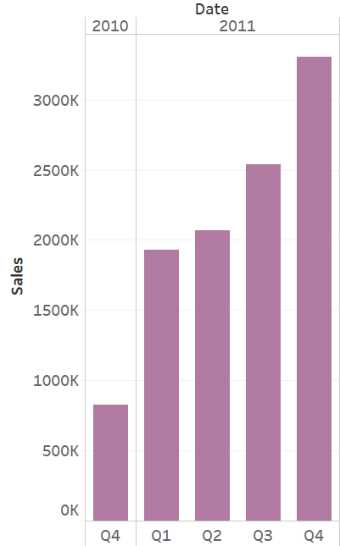
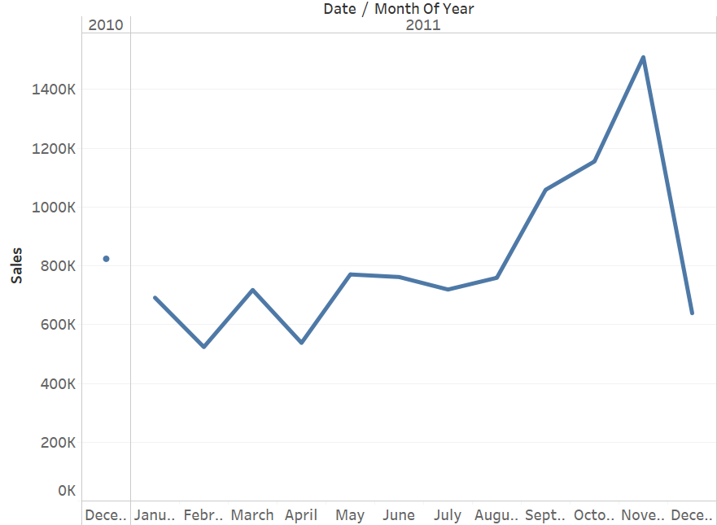
Analyzing Trends
1) Is the company's performance improving or degrading over time?
Sales are observed by aggregating on a monthly [Fig 1.a] and quarterly [1.b] basis.
We observe an increasing trend in both quarterly and monthly sales graphs.
Fig 1.a: Monthly Sales
Fig 1.b: Quarterly Sales

Slide 4
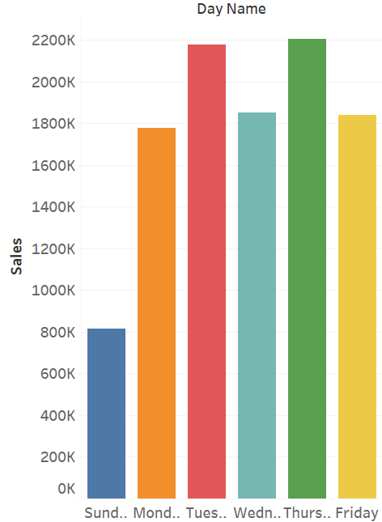
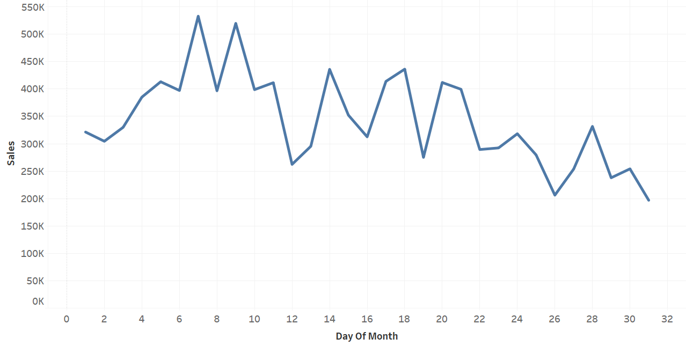
Important Trends and Highlights
Sales per Day of Week
Sales per Day of Month
Sales are higher at the beginning of every month and decline as we go through the month.
Most of the revenue is generated on weekdays.

Slide 5
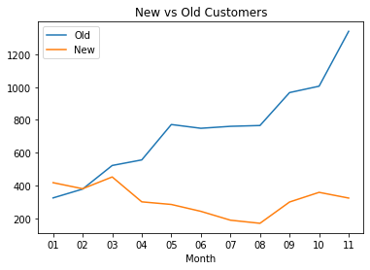
Customer Acquisition and Loyalty
2. How can we measure our performance in terms of customer acquisition and building customer loyalty?
Data cleaning/ manipulation:
Null values in customer id were removed.
The data was segregated into two parts:
New: Where the customers made their first ever transaction.
Old: Where the customers had already made a transaction before.
Analysis:
Although we see addition of new customers every month, the trend is slightly negative.
The count of old customers is increasing every month which indicates our customers are staying loyal to us.

Slide 6
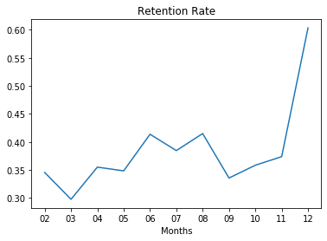
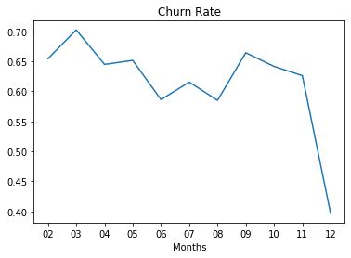
Metrics to get the the performance of customer loyalty
Monthly Retention Rate = Retained Customers From Previous Month/Active Customers Total
It signifies how good are we in retaining customers from the last month.
Churn Rate = 1 - Monthly Retention Rate
It signifies likelihood of a customer to churn.
Monthly retention rate is increasing (churn rate is decreasing) implying increasing number of loyal customers

Slide 7
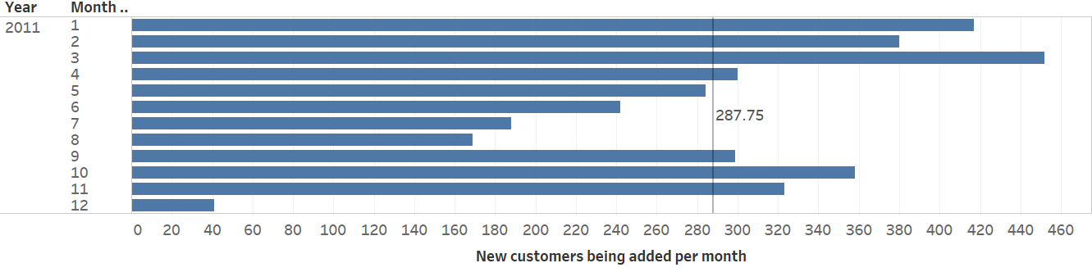
Relationships and Drivers of Sales
Keeping loyal customers intact: 1091 customers have greater than 100 transactions, major drivers of revenue.
Customer acquisition: The average number of customers acquired per month is nearly 288 which are addition to our sales every month.
Huge product range: Company sells products with unit price ranging from 0.001 to 13541.33, thus has a good product range to cater to different customers.
Largest Market Area: 85.61% of all the sales are from United Kingdom implying it is the biggest source of revenue. Focussing on UK and similar markets can drive much better sales.

Slide 8
Kind of Customers
4) What kind of customers do typically buy from us?
Based on data available we can divide customers on the basis of:
Geographical segmentation:
Based on transaction country
Based on transaction region (Asia, Australia, Europe, North America, South America, Unspecified)
Customer Value:
High Value customers = 104 (considering total sales amount> 10000)
Medium Value Customers = 1564 (considering total sales amount> 1000)
Low Value Customers = 2670 (considering total sales amount< 1000)
Frequency of Transactions by various customer
High Frequency Buyers = Customers with more than 102 transactions (top 25% frequent buyers)
Medium Frequency Buyers= Customers having transactions between 17 to 102
Low Frequency Buyers =Customers with less than 17 transactions (bottom 25% frequent buyers)

Slide 9
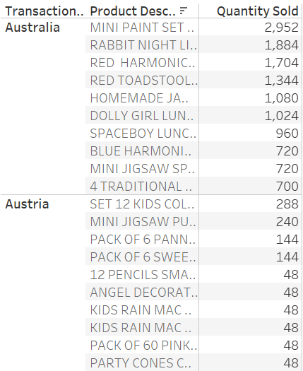
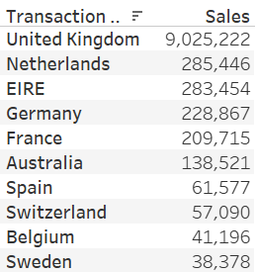
Initiatives to Increase Sales
Based on geographical segmentation:
Target new customers of any country with the best selling products in that particular country.
Perform machine learning to recommend similar products to already acquired customers.
Allocate resources with priorities to those countries which have the highest total sales.
Based on customer value:
High Value: Improve Retention
Mid Value: Improve Retention +
Increase Frequency
Low Value: Increase Frequency
Top 10 countries by sales
Top 10 products by country

Slide 10
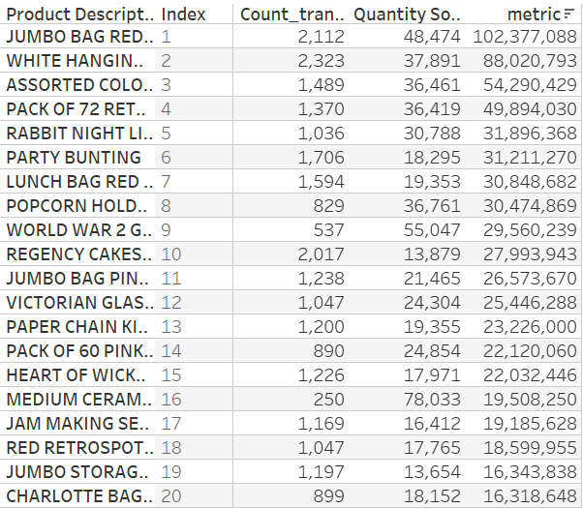
Preventing out of stock situations
To understand which products are in most demand, we have to consider [* Note]
Total number of transactions in which a product is purchased.
Total quantity of the product sold.
To calculate the impact of both simultaneously, I created a metric which is simply the product of number of transactions and total quantity
Analysis:
The products are ranked based on the metric calculated above and arranged in the order of their ranks in a table.
Thus we can prevent out of stock situations for the products which are in most demand and responsible for most of the sales.
* Note: Metric is designed to give priority to products which are sold frequently.

Slide 11
THANK YOU

